Slide 1
Introduction to Angular 2
Angular 1 was released in October 2010, and by far the most popular JavaScript framework available for creating web applications.
Many developers are already using Angular 1, so the obvious question that comes to our mind is why should we use Angular 2. Angular 2 is not a simple upgrade from angular 1.
Angular 2 is completely rewritten, so it has lot of improvements when compared with Angular 1.
Let's look at a few of these improvements.

Slide 2
Performance :
From a performance standpoint, Angular 2 has faster initial loads, change detection, and improved rendering time. Not just performance, we also have improved modularity, Dependency injection and testability. According to angular conference meetup, Angular 2 is 5 times faster compared to AngularJS 1.
Mobile Support : Angular 1 was not built for mobile devices. It is possible to run Angular 1 on mobile but we will have to use other frameworks. Angular 2 on the other hand is designed from the ground up with mobile support. Mobile device features and limitations like touch interfaces, limited screen real estate, and mobile hardware have all been considered in Angular 2. So with Angular 2 we can build a single application that works across mobile and desktop devices.
Component Based Development : Component based web development is the future of web development. In Angular 2, "everything is a component". Components are the building blocks of an Angular application. The advantage of the component-based approach is that, it facilitates greater code reuse. From unit testing standpoint, the use of components make Angular2 more testable. We will discuss what a component is and how to build components with examples in detail, in our upcoming videos.

Slide 3
More language choices :
There are several languages that we can use to develop Angular applications. To name a few, we have 1. ECMAScript 5 2. ECMAScript 6 (also called ES 2015) 3. TypeScript etc.
Besides these 3 languages we can also use Dart, PureScript, Elm, etc, but among all these, TypeScript is the most popular language. Angular 2 itself, is built using TypeScript.
TypeScript has great support of ECMAScript 6 standard.
So the obvious questions that come to our mind at this point are 1. What is ECMAScript 2. What is Type Script

Slide 4
What is ECMAScript :
The JavaScript language standard is officially called ECMAScript.
Over the past several years many versions of ECMAScript were released starting with ECMAScript version 1 all the way till ECMAScript version 7.
Most of the modern browsers available today support ECMAScript 5.
The browser support for ECMAScript 6 is still incomplete.
However, using a process called Transpilation, ECMAScript 6 can be converted to ECMAScript 5 which is supported by all the modern browsers.
ECMAScript 6 is officially known as ECMAScript 2015.
ECMAScript 2015 introduced several new features like classes, modules, arrow functions etc.
If you are interested in reading more about the ECMAScript standard and what these different versions of ECMAScript have to offer, please refer to the the following Wikipedia article. https://en.wikipedia.org/wiki/ECMAScript

Slide 5
What is Type Script : TypeScript is a free and open-source programming language developed by Microsoft. It is a superset of JavaScript and compiles to JavaScript through a process called transpilation. Using TypeScript to build angular applications provides several benefits.
1. Intelligence 2. Auto completion 3. Code navigation 4. Advanced refactoring 5. Strong Typing 6. Supports ES 2015 (also called ES 6) features like classes, interfaces and inheritance.
If you have any experience with object oriented programming languages like C# and Java, learning TypeScript is easy.

Slide 6
TypeScript is supported by several IDEs like
1. Visual Studio Code 2. Eclipse 3. WebStorm 4. Atom 5. Sublime Text etc.

Slide 7
Setting up Angular 7 in Visual Studio:
Step 1 : Download git from https://git-scm.com/ link
Verify: git --version {2.18.0}
Step 2 : Install Node and NPM using the link below. https://nodejs.org/en/download/
Verify: node –version {8.x}
npm --version {5.x}
Step 3 : Install angular cli 7
npm install –g @angular@cli {First Time}
OR
npm install –g @angular@cli@latest {Update}
Verify: ng –version {7.x}
Step 4:Download visual studio code from https://code.visualstudio.com/download

Slide 8
Create a new Angular 7 project using the Angular CLI :
Step1:
ng new ProjectName -d
OR
ng new ProjectName --skip-tests
Step2:
cd ProjectName
Step3:
ng serve -o

Slide 9
What is a component in Angular
A component in Angular is a class with a template and a decorator. So in simple terms a component in Angular is composed of these 3 thing
Template -
Defines the user interface.
Contains the HTML, directives and bindings.
Class -
Contains the code required for template.
Just like a class in any object oriented programming language like C# or Java, a class in angular can contain methods and properties.
Properties contain the data that we want to display in the view template and methods contain the logic for the view.
We use TypeScript to create the class.
Decorator -
We use the Component decorator provided by Angular to add metadata to the class.
A class becomes an Angular component, when it is decorated with the Component decorator.
Visit : https://angular.io/api/core/Component

Slide 10
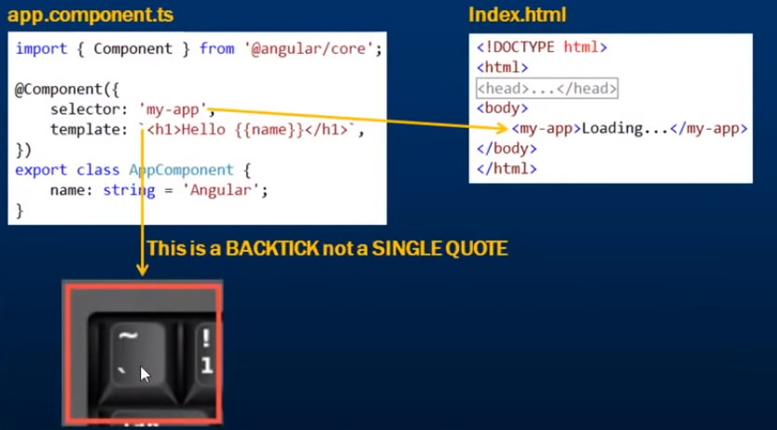

Slide 11
template vs templateurl
Template:
template: '<h1>Hello {{name }}</h1>‘
OR
template: "<h1>Hello {{name }}</h1>“
OR
template: `<h1> Hello {{name }} </h1>`
If you have the HTML in more than one line, then you have to use backticks instead of single or double quotes as shown below.
If you use single or double quotes instead of backticks you will get an error.

Slide 12
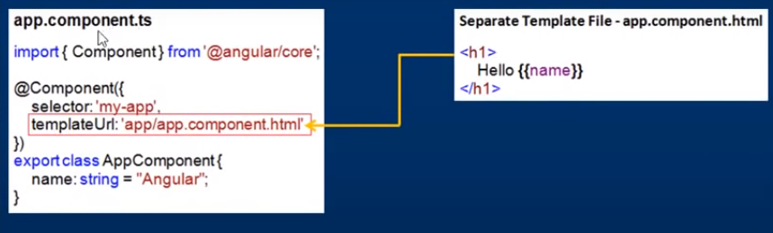
template vs templateurl
Templateurl:
Instead of using an inline view template, you can have it in a separate HTML file. Here are the steps to have the view template in a separate HTML file

Slide 13
template vs templateurl
With an inline template
We loose Visual Studio editor intelligence, code-completion and formatting features.
TypeScript code is not easier to read and understand when it is mixed with the inline template HTML.
With an external view template
We have Visual Studio editor intelligence, code-completion and formatting features and
Not only the code in "app.component.ts" is clean, it is also easier to read and understand

Slide 14
Angular nested components
As we already know Angular is all about components.
A component in Angular allows us to create a reusable UI widget.
A component can be used by any other component.
Let's look at a simple example of nesting a component inside another component.

